Slide 1
Eight Way Symmetry
Midpoint Line Drawing Algorithm

Slide 2
Midpoint Line Drawing Algorithm
Midpoint (x₁, y₁, x₂, y₂){
dx= x₂ - x₁ ; dy = y₂ - y₁ ;
D = 2*dy – dx; ∆NE = 2*(dy-dx) ; ∆E = 2*dy ;
x= x₁ ; y = y₁ ;
while( x ≤ x₂){
Draw(x, y);
x++ ;
if (D>0){
y++;
D = D+ ∆NE ;
}
else{
D = D+ ∆E ;
}
}
}

Slide 3
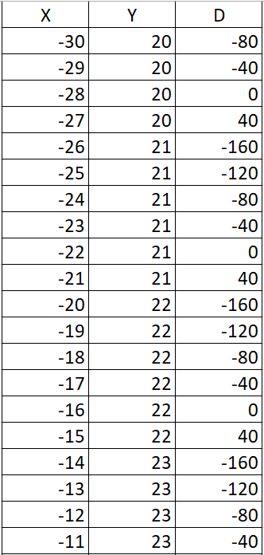
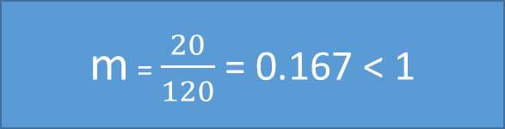
(-30, 20) to (90, 40)
dx= 90 + 30 = 120 ; dy = 40- 20 = 20;
D = 2*20 – 120 = -80; ∆NE = 2*(20-120) = -200 ; ∆E = 2*20 = 40;
m = $\frac{20}{120}$ = 0.167 < 1

Slide 4
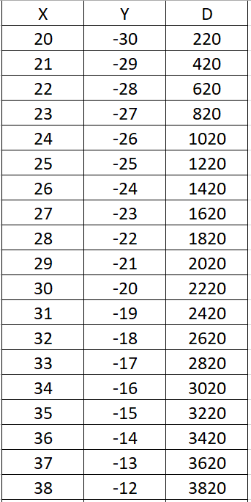

(20, -30) to (40, 90)
dy= 90 + 30 = 120 ; dx = 40- 20 = 20;
D = 2*120 – 20 = 220; ∆NE = 2*(120-20) = 200 ; ∆E = 2*120 = 240;
m = $\frac{120}{20}$ = 6 >1

Slide 5
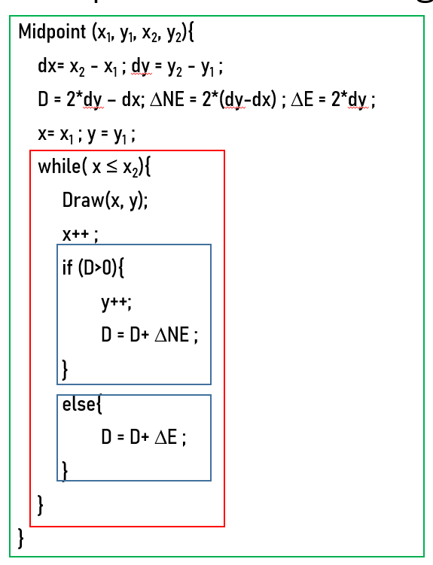
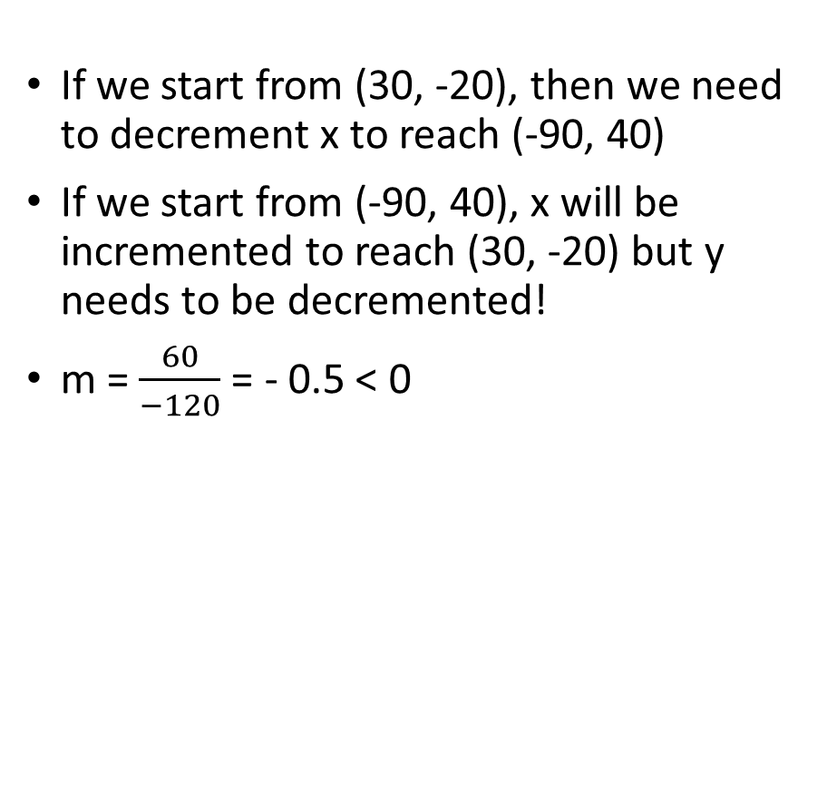
(30, -20) to (-90, 40)
If we start from (30, -20), then we need to decrement x to reach (-90, 40)
If we start from (-90, 40), x will be incremented to reach (30, -20) but y needs to be decremented!
m = $\frac{60}{−120}$ = - 0.5 < 0

Slide 6
x₁, y₁
Midpoint Line Drawing Algorithm
Coordinates (x, y) of points on the line
x₂, y₂

Slide 7
Eight Way Symmetry
FindZone(x₁, y₁, x₂, y₂){
dx= x₂ - x₁ ; dy = y₂ - y₁ ;
if(|dx| > |dy|){
if(dx>0 && dy>0) zone = 0;
else if(dx<0 && dy>0) zone =3;
else if (? ?) zone = ? ;
else if (? ?) zone = ?
}
else{
if(dx>0 && dy>0) zone = 1;
else if(dx<0 && dy>0) zone =2;
else if (? ?) zone = ? ;
else if (? ?) zone = ?
}
}
Zone: 2
dx<0, dy>0, |dy|>|dx|
Zone: 1
dx>0, dy>0, |dy|>|dx|
Zone: 3
dx<0, dy>0, |dx|>|dy|
Zone: 0
dx>0, dy>0, |dx|>|dy|
Zone: 4
?
Zone: 7
?
Zone: 5
?
Zone: 6
?

Slide 8
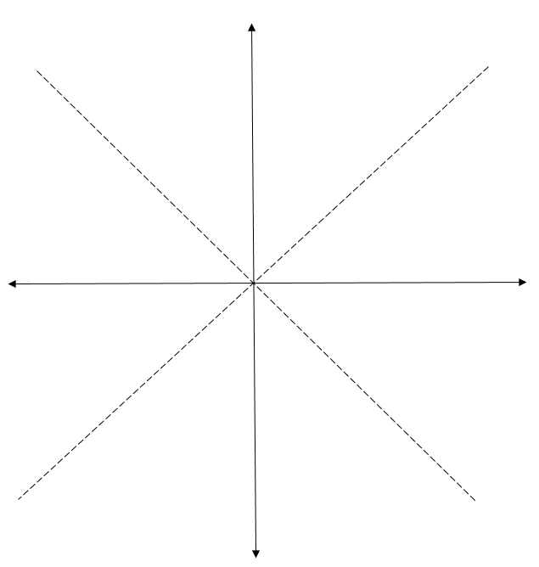
2
1
3
0
(100, 35)
4
7
(-50, -15)
5
6

Slide 9
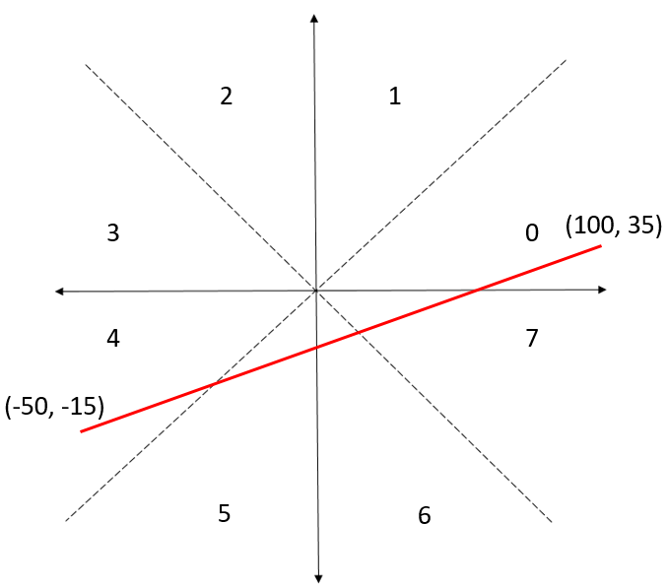
dx = 100 + 50 = 150 > 0
dy = 35 + 15 = 50 > 0
|dx| > |dy|
Zone = 0

Slide 10
How do we utilize the zones?

Slide 11
Input (x₁, y₁) to (x₂,y₂) for a line of Zone M, where M ={0, 1, …, 7}
Convert the coordinates of a line in Zone M into the coordinates of a line in Zone 0
Use the existing midpoint line drawing algorithm for Zone 0
Convert the points (x, y) back to original Zone M
FindZone
?
MidPoint
?

Slide 12
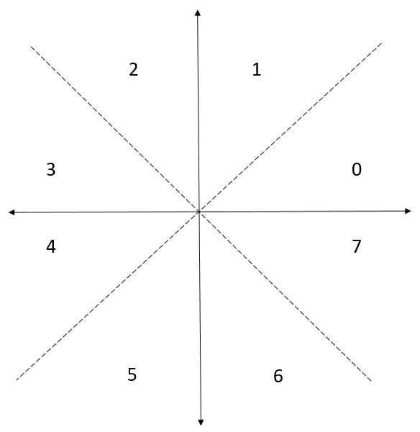
Convert the coordinates of Zone M into the coordinates of Zone 0 Zone 1 → Zone 0
Coordinates in Zone 1: ( X, Y ) becomes (Y , X) in Zone 0
(5, 50)
ConvertToZone0 (X, Y, zone){
if (zone == 1){
x = Y, y = X
}
return (x, y)
}
(50, 5)

Slide 13
Convert the coordinates of Zone M into the coordinates of Zone 0 Zone 2 → Zone 0
Coordinates in Zone 2: ( X, Y ) becomes (Y , - X) in Zone 0
(-5, 50)
ConvertToZone0 (X, Y, zone){
if (zone == 1){
x = Y, y = X
}
else if (zone ==2){
x = Y, y = -X
}
return (x, y)
}
(50, 5)

Slide 14
Convert the coordinates of Zone M into the coordinates of Zone 0 Zone 3 → Zone 0
Coordinates in Zone 3: ( X, Y ) becomes (-X, Y) in Zone 0
ConvertToZone0 (X, Y, zone){
if (zone == 1){
x = Y, y = X
}
else if (zone ==2){
x = Y, y = -X
}
else if (zone ==3){
x = -X , y = Y
}
….
return (x, y)
}
(-50, 5)
(50, 5)
DIY for zone 4, 5, 6, 7

Slide 15
Input (x₁, y₁) to (x₂,y₂) for a line of Zone M, where M ={0, 1, …, 7}
Convert the coordinates of a line in Zone M into the coordinates of a line in Zone 0
Use the existing midpoint line drawing algorithm for Zone 0
Convert the points (x, y) back to original Zone M
FindZone
ConvertToZone0
MidPoint
?

Slide 16
Go back to original zone M Zone 0 → Zone 1
Coordinates in Zone 0: ( X, Y ) becomes (Y , X) in Zone 1
(5, 50)
OriginalZone (X, Y, zone){
if (zone == 1){
x = Y, y = X
}
return (x, y)
}
(50, 5)

Slide 17
Go back to original zone M Zone 0 → Zone 2
Coordinates in Zone 0: ( X, Y ) becomes (-Y , X) in Zone 2
(-5, 50)
OriginalZone (X, Y, zone){
if (zone == 1){
x = Y, y = X
}
else if(zone == 2){
x = -Y, y = X
}
return (x, y)
}
(50, 5)

Slide 18
Go back to original zone M Zone 0 → Zone 3
Coordinates in Zone 0: ( X, Y ) becomes (-X , Y) in Zone 3
OriginalZone (X, Y, zone){
if (zone == 1){
x = Y, y = X
}
else if(zone == 2){
x = -Y, y = X
}
else if (zone ==3){
x = -X , y = Y
}
….
return (x, y)
}
(-50, 5)
(50, 5)
DIY for zone 4, 5, 6, 7

Slide 19
Input (x₁, y₁) to (x₂,y₂) for a line of Zone M, where M ={0, 1, …, 7}
Convert the coordinates of a line in Zone M into the coordinates of a line in Zone 0
Use the existing midpoint line drawing algorithm for Zone 0
Convert the points (x, y) back to original Zone M
FindZone
ConvertToZone0
MidPoint
OriginalZone

Slide 20
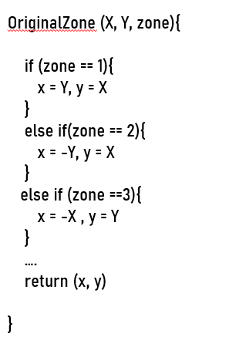
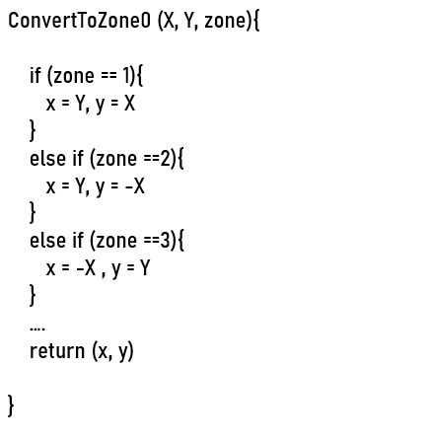
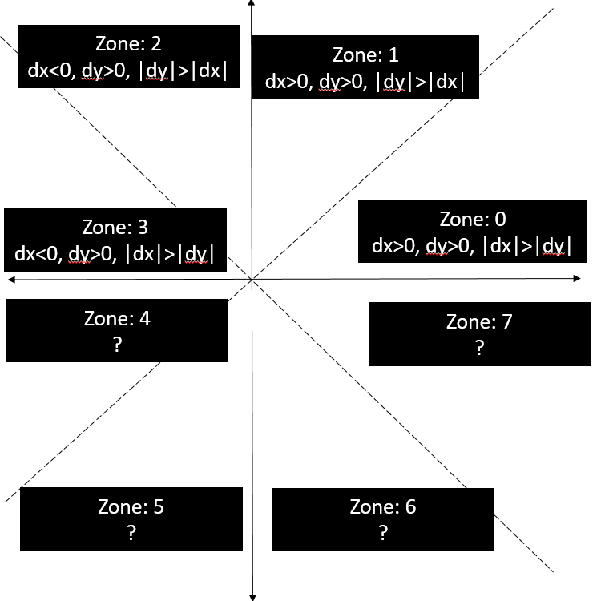
(-10,-20) to (-20, 70)
dx = -20 +10 = -10 < 0
dy = 70 + 20 = 90 > 0
|dy| > |dx|, zone = 2
(-10, -20) → (-20, 10) and (-20, 70) →(70, 20)
dx’ = 70 + 20 = 90, dy’ = 20-10 = 10
D = 2*10-90 = -70, ∆NE = 2*(10-90)= -160, ∆E=2*10=20
X’ | Y’ | D | X | Y
-20 | 10 | -70 | -10 | -20
-19 | 10 | -50 | -10 | -19
-18 | 10 | -30 | -10 | -18
-17 | 10 | -10 | -10 | -17
-16 | 10 | 10 | -10 | -16
-15 | 11 | -150 | -11 | -15
-14 | 11 | -130 | -11 | -14

